Slide 1




IP ADDRESS
Presented by: Narmeen Najeeb
Maryam Tariq
Tehreem

Slide 2


OVERVIEW
01
02
03
introduction
how it works
types
04
05
classes
conclusion

Slide 3

INTRODUCTION TO IP ADDRESSES
An IP ADDRESS or INTERNET PROTOCOL ADDRESS is a unique identifier assigned to each device connected to a network.
It allows the device to communicate with other devices over the internet or local networks.
Think of it as a device’s “home address”, allowing info to know where to go and where it came from.

Slide 4

IP ADDRESS PYRAMID
to visualise the concept of ip addresses you can imagine a pyramid:
01
Internet Assigned Numbers Authority (IANA) is responsible for allocation of ip addresses to RIRs it oversees the entire distribution of ip addresses.
IANA
02
Regional Internet Registries(RIRs) are regional bodies that receive large blocks of IP Addresses from IANA. they are responsible for further specific geographical regions. There are five main RIRs:
1. ARIN (North America ) 2. RIPE NCC (Europe,Middle East, Central Asia) 3.APNIC (Asia-Pacific) 4.LACNIC (Latin America and Caribbean) 5. AFRINIC (Africa)
RIRs
03
Internet Service Provider (ISP) receives blocks of ip addresses from RIRs and allocate then to end users such as businesses and residential customers. link between end-user and the larger internet
ISPs
04
From the ISPs or sometimes RIRs ,organizations receive blocks of ip addresses and used to manage devices within their private networks.
Individual devices connected to internet like laptops, ,smartphones etc receive unique ips either dynamic or statically to communicate on network.
Organizations and Enterprises
End user / Devices

Slide 5


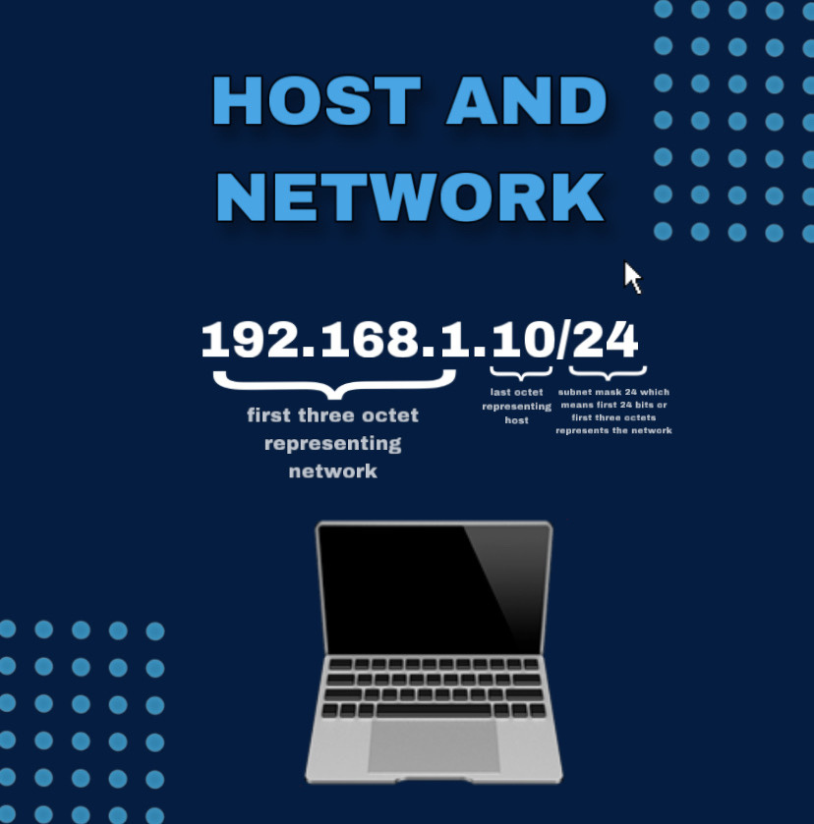

HOW IP ADDRESSES WORK?
WHEN A DEVICE WANTS TO SEND OR RECEIVE DATA ,ITS
IP ADDRESS SERVES AS A DESTINATION OR SOURCE.
Data packets are sent accross networks, with routers helping direct these packets to their correct destination using IPS.
Each IP Address has two main parts:
A. Network Part:
Identifies the network the device belongs to.
B. Host Part:
Identifies the specific device on that network.

Slide 6



IP ADDRESSES AND THE DNS
The DOMAIN NAME SYSTEM (DNS) is an essential part of how the internet works
Prime purpose:
To translate HUMAN-READABLE domain names into MACHINE-READABLE IP addresses
Why DNS Exists:
While computers and devices on the internet use IP Addresses to communicate, IP Addresses are hard for humans to remember. DNS was created to solve this problem. It acts like the internets “PHONE BOOK”, matching domain names with the corresponding IP Addresses that need to connect.
Example:
www.wikipedia.org -------> 91.198.174.192.
(note that ips of large websites may vary depending upon region to ensure high performance)

Slide 7



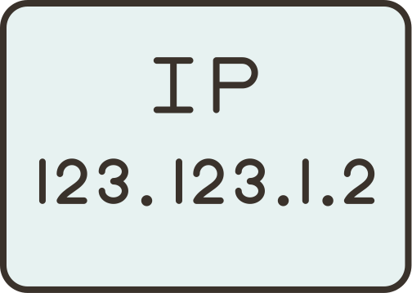
TYPES OF IP ADDRESS
BASED ON PERMANENCE
BASED ON VERSION
BASED ON SCOPE OF USE
A. Static IP Address
A. IPv4 (Internet Protocol Version 4)
IPv6 (Internet Protocol Version 6)
A. Public IP Address
B. Private IP Address
B. Dynamic IP Address

Slide 8
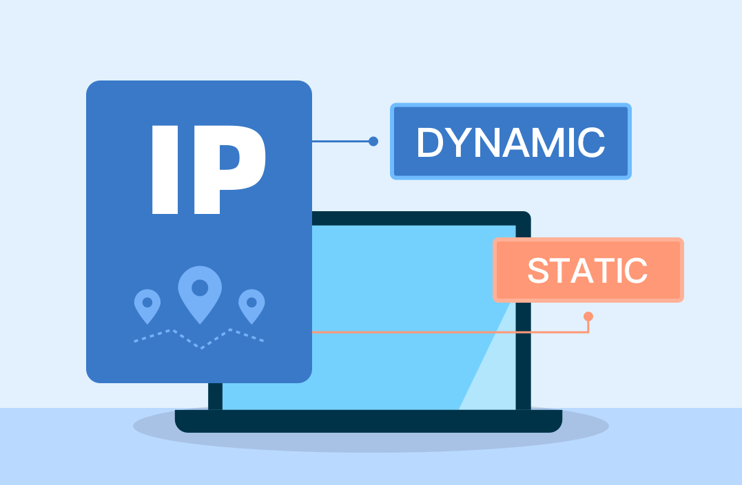
IP ADDRESS TYPES BY PERMANENCE
A. Static IP Address:
Permanent: Doesn't change.
Assigned manually.
Used for servers, websites, etc.
B. Dynamic IP Address:
Temporary: Changes periodically.
Assigned by DHCP.
Common for home and office devices.

Slide 9


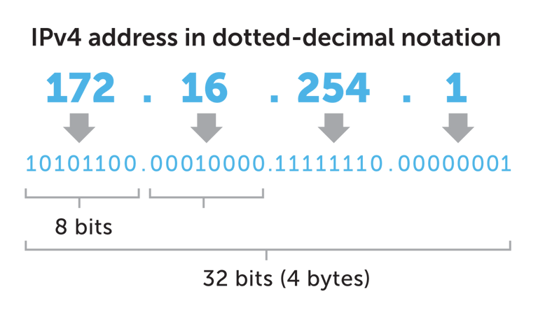
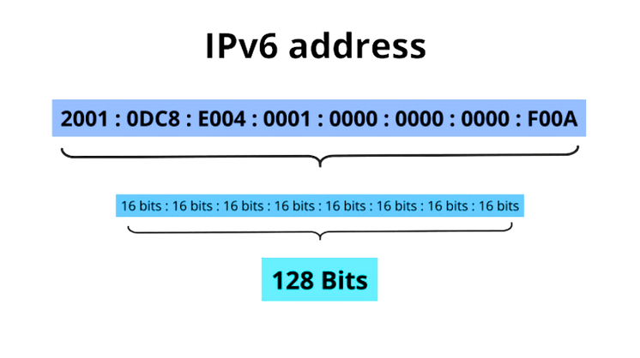
IPv4
length = 32 bits
octet 4
4 billion (2^32)
eg: N.N.N.N
where N = XXXXXXXX
one X = 1 bit
range = 0-255
IP ADDRESS TYPES BY VERSION
8 bits
4 bytes 32 bits
IPv6
length = 128 bits
8 groups of 4 hexadecimals
340 undecillion (2^128)
eg: XXXX:XXXX:XXXX:XXXX:XXXX:XXXX:XXXX:XXXX
where one X = 4 bits
range = 0 - FFFF (65535)

Slide 10




IPV4 AND IT’S DRAWBACK
limited address
lack of security
only about 4 billion IPs available. World population exceeding 8 billion currently.
Not enough for the growing number of devices, considering people these days own more than one device.
IPv4 was designed without security in mind. Although security protocols like IPsec can be used, they are not inherently integrated into the protocol, leaving IPv4 networks vulnerable to various attacks.

Slide 11




ADVANTAGES OF IPv6
Larger Address Space
IPv6 provides an enormous address space of 128 bits, allowing for approximately 340 undecillion unique addresses (2^128). This ensures sufficient addresses for the growing number of internet-connected devices.
Improved Security Features
IPv6 includes IPsec as a fundamental part of the protocol suite, enhancing the security of data transmission through encryption and authentication, which helps protect against attacks.

Slide 12







IP ADDRESS TYPES BY SCOPE OF USE
1
2
PRIVATE IP ADDRESS
PUBLIC IP ADDRESS
Definition: Public IP addresses are assigned to devices that connect directly to the internet. They are unique across the entire internet.
Accessibility: Devices with public IPs can be accessed from anywhere on the internet.
Allocation: Public IPs are assigned by the Internet Assigned Numbers Authority (IANA) and are routed over the internet.
Example: An IP like 192.0.2.1 is a public IP.
Definition: Private IP addresses are used within private networks and are not routable on the internet. They are not unique globally.
Accessibility: Devices with private IPs can communicate with each other within the same local network but cannot be accessed directly from the internet.
Allocation: Private IP ranges are defined by (IETF) and are reserved for Example: An IP like 192.168.1.1 is a private IP.
The common private IP ranges are:
10.0.0.0 to 10.255.255.255
172.16.0.0 to 172.31.255.255
192.168.0.0 to 192.168.255.255

Slide 13



A
CLASSES OF IP ADDRESS
First bit (binary): Always 0
First octet: 0–127
Address range: 1.0.0.0 to 126.255.255.255
The default subnet mask is 255.0.0.0, meaning the first 8 bits (or the first octet) are used for the network identifier, and the remaining 24 bits (last 3 octets) are used for the host identifier.
Number of networks: 128 (2^7, but 0 and 127 are reserved for loopback addresses.)
Number of hosts per network: 16,777,214 (16 M)
Usage: Typically for large networks (e.g., large corporations or ISPs)
IP addresses are classified based on their network and host components, which determine how many devices can be connected within a network. The classification is primarily based on the range of the address's first few bits and divides the IP address space into five classes: A, B, C, D, and E.

Slide 14




B
C
First two bits: Always 10
Address range: 128.0.0.0 to 191.255.255.255
Default subnet mask: 255.255.0.0,
the first 16 bits are for the network, and the remaining 16 bits are for hosts.
Number of networks: 16,384
Number of hosts per network: 65,534
Usage: Medium-sized networks, universities, and ISPs.
First three bits: Always 110
Address range: 192.0.0.0 to 223.255.255.255
Default subnet mask: 255.255.255.0,
the first 24 bits are for the network, and the remaining 8 bits are for hosts.
Number of networks: 2,097,152
Number of hosts per network: 254
Usage: Small networks, like local area networks (LANs).

Slide 15


D
E
(Multicast)
(Experimental)
First four bits: Always 1110
First octet: 224–239
Address range: 224.0.0.0 to 239.255.255.255
Purpose: Reserved for multicasting (sending data to multiple hosts), not for standard network/host use, so they don’t have the same network/host split.
Key Use: Allows data to be sent to multiple devices simultaneously.
First four bits: Always 1111
First octet: 240–255
Address range: 240.0.0.0 to 255.255.255.255
Purpose: Reserved for research and experimental purposes and future use. Not for normal usage.
Not used for public or private networks.

Slide 16
Thank you

